Slide 1
Course Objectives
To understand purpose of database management system
Apply concepts like database design and database languages in managing data
Importance of normalization in dbms and SQL in implementation of database access
Knowledge of transaction control , recovery strategies , storage and indexing etc

Slide 2
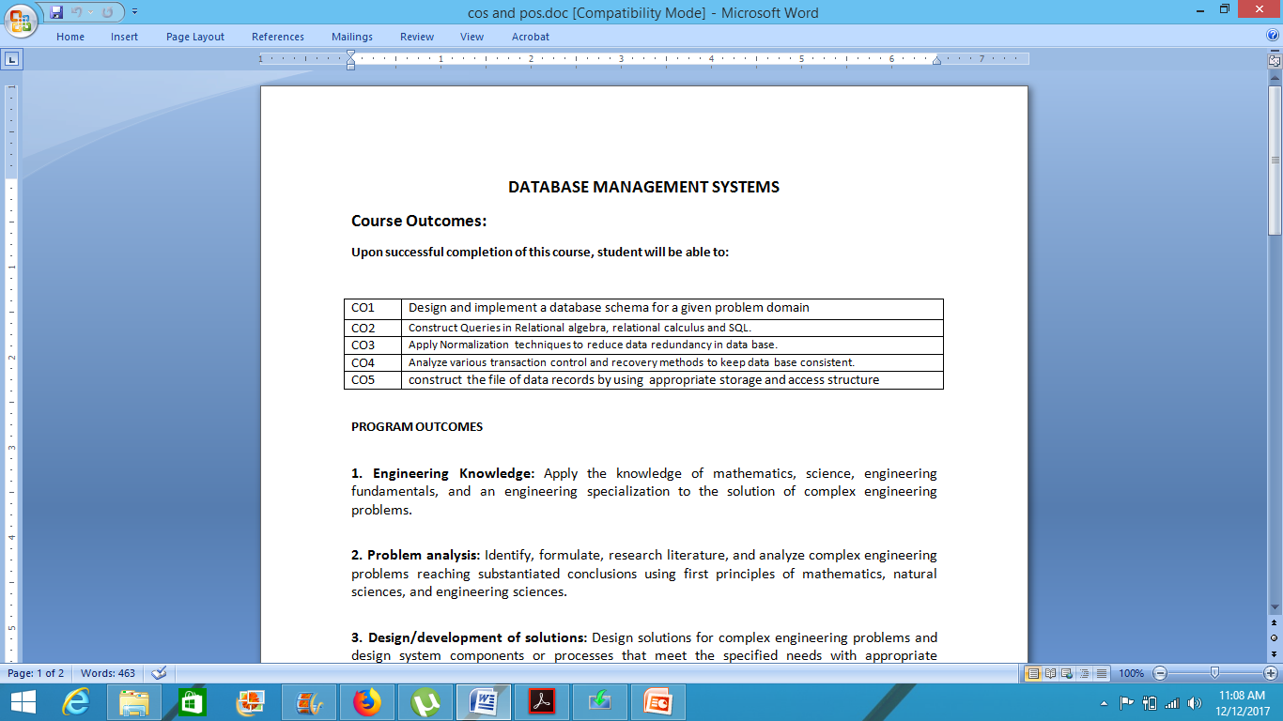
Course Outcomes

Slide 3
Text Book
1. Database Management Systems,
Raghurama Krishnan, Johannes Gehrke (2007),
3rd Edition, Tata McGraw-Hill, New Delhi, India
2. Database System Concepts,
Abraham Silberschatz, Henry F. Korth, S.Sudarshan (2010),
6th Edition, McGraw-Hill, New Delhi, India.

Slide 4
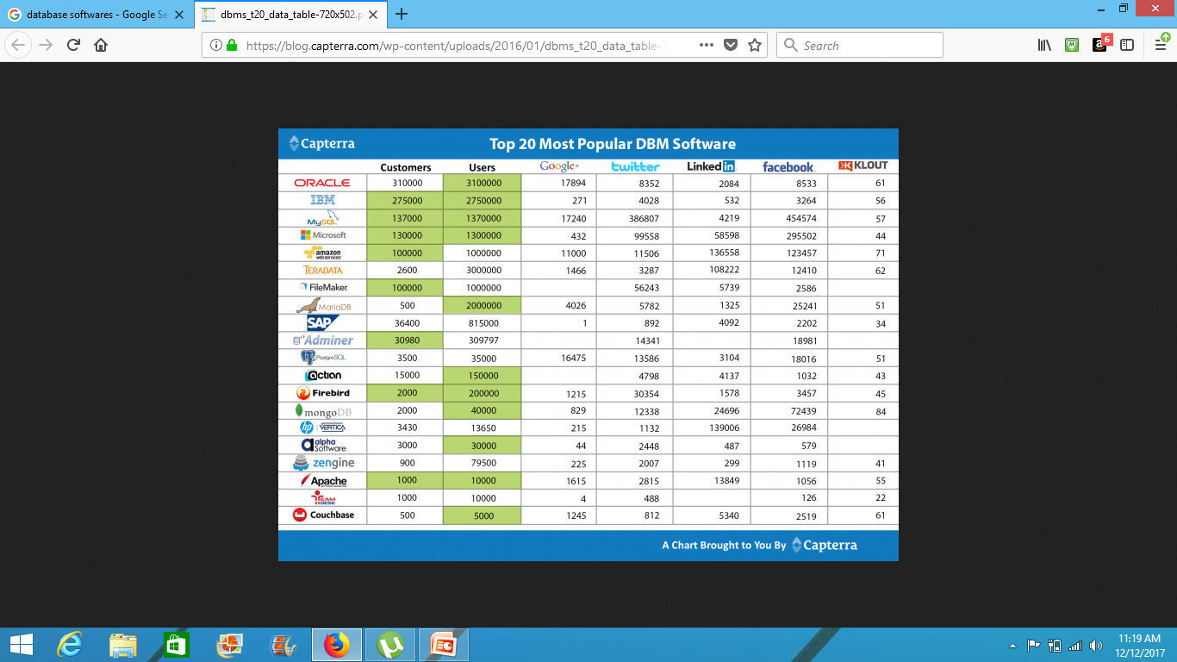

Slide 5
Roles
Data Engineer
Data Scientist etc

Slide 6
History of database systems
Integrated Data Store, First general purpose DBMS by charles bachman at General Electric.[Network Model]
IBM’s Information Management System(IMS)[hierachial data model]
SABRE system for making airline reservations By American airlines and IBM
In 1970,at IBM’s San Jose Research laboratory proposed relational data model
In 1980’s, SQL for relational databases by IBM
Database transaction management james gray 1999
IBM’s DB2, Oracle 8, Informix UDS
ERP and MRP
DBMS with internet
Multimedia databases, streaming data, digital libraries ,NASA’s earth observation system project
Decision making and mining data repositories

Slide 7
Introduction to database management systems
Data: Data represents known facts or raw information in unorganized form (such as alphabets or numbers or symbols ) .
Database: Database is a organized collection of data describing the activities of one or more related organizations.
Database management system(DBMS) is a software designed to assist in storing, maintaining and utilizing large collections of data.
    or
    A database-management system (DBMS) is a computer-software application which interacts with end-users, other applications, and the database itself to access,update,manage and analyze data with the help of set of application programs.

Slide 8
Advantages of Database management systems
Data Independence
Efficient data access
Data integrity and security
Data administration
Concurrent access and crash recovery
Reduced application development time

Slide 9
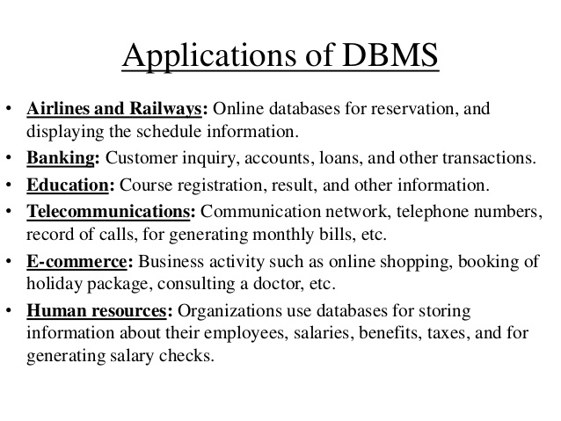
Database systems applications

Slide 10
Applications of Database Management systems
Enterprise Information
  Sales
  Accounting
  Human resources
  Manufacturing
  Online retailers
  Finance and Universities

Slide 11
Database systems Vs file systems
File storage refers to a collection of operating system files.
DBMS features to manage the data in a robust and efficient manner.

Slide 12
Advantages of dbms over file system
No redundant data – Redundancy removed by data normalization
Data Consistency and Integrity – data normalization takes care of it too
Secure – Each user has a different set of access
Privacy – Limited access
Easy access to data
Easy recovery
Flexible

Slide 13
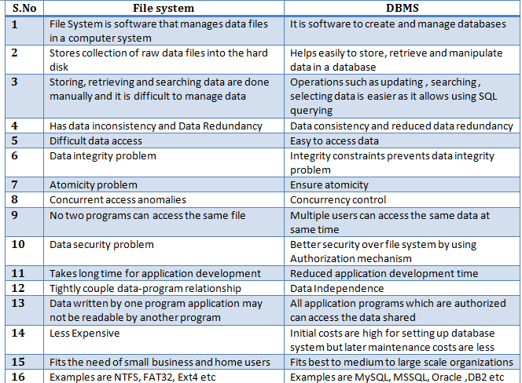

Slide 14
View of data
Abstraction
Data Abstraction
Instance and schema

Slide 15

Abstraction :Hiding unnecessary details from the user and providing abstract view of data which is required to users.
Data Abstraction: Database systems are made-up of complex data structures. To ease the user interaction with database, the developers hide internal irrelevant details from users. This process of hiding irrelevant details from user is called data abstraction.

Slide 16
Schema
Design of a database is called schema.
3 types:
  Physical schema
  Logical schema
  View schema

Slide 17
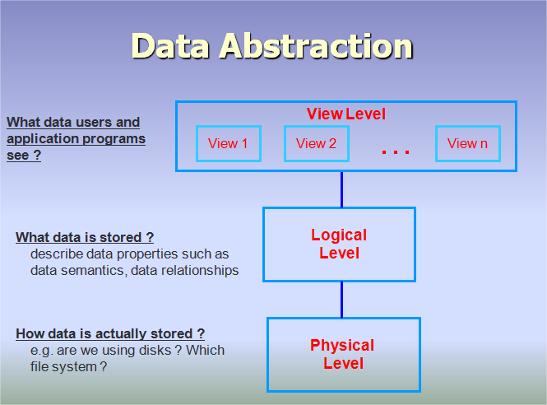
Three levels of Data Abstraction

Slide 18
Data models
Data models determines the logical structure of a database
A Data Model is a logical structure of Database. It describes the design of database to reflect entities, attributes, relationship among data, constrains etc.

Slide 19
Data models
Relational data model
Entity – relationship model
Hierarchical data model
Network model
Object oriented model
Object relational model
Semi structured data model
Flat data model

Slide 20
Hierarchical data model
A hierarchical database model is a data model in which the data is organized into a tree-like structure. The data is stored as records which are connected to one another through links.
A record is a collection of fields, with each field containing only one value.

Slide 21
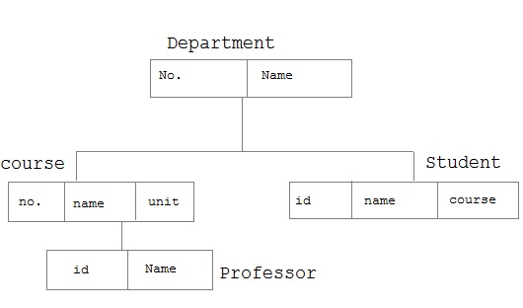
Example for hierarchical model

Slide 22
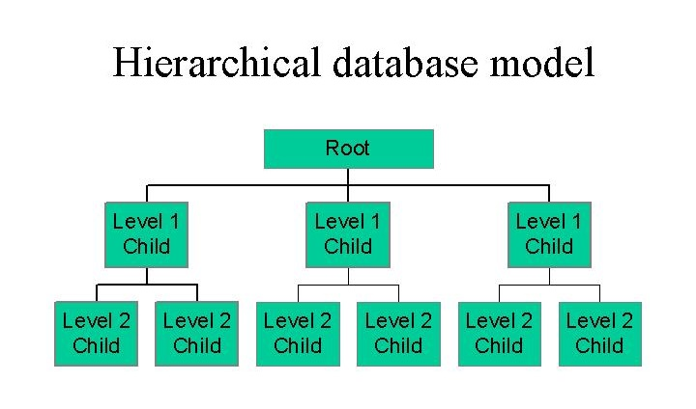
Example of hierarchical model

Slide 23
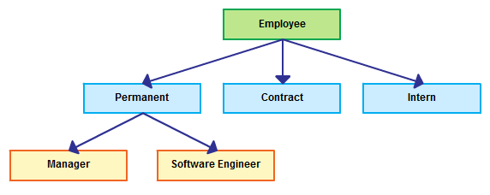
Hierarchical model

Slide 24
Network model
In the network model, entities are organized in a graph, in which some entities can be accessed through several paths.

Slide 25
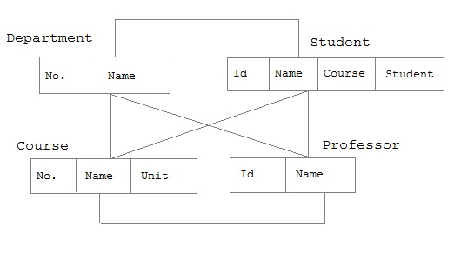
Network data model example

Slide 26
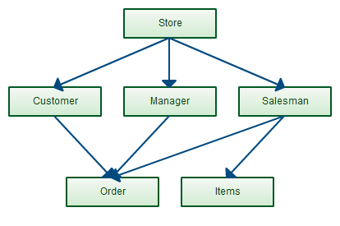
Example for network model

Slide 27
Object oriented data model
This data model is another method of representing real world objects.
It considers each object in the world as objects and isolates it from each other.
It groups its related functionalities together and allows inheriting its functionality to other related sub-groups.

Slide 28
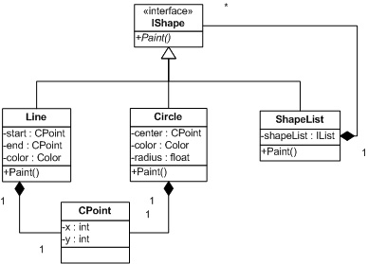
Object oriented model

Slide 29
Object relational data model
An object-relational database (ORD), or object-relational database management system (ORDBMS), is a database management system (DBMS) similar to a relational database, but with an object-oriented database model: objects, classes and inheritance are directly supported in database schemas and in the query language

Slide 30
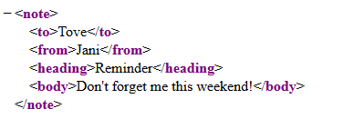
Semi structured data model:
The semi-structured data model is designed as an evolution of the relational data model that allows the representation of data with a flexible structure.
Semi-structured data model is model where schema is part of data

Slide 31
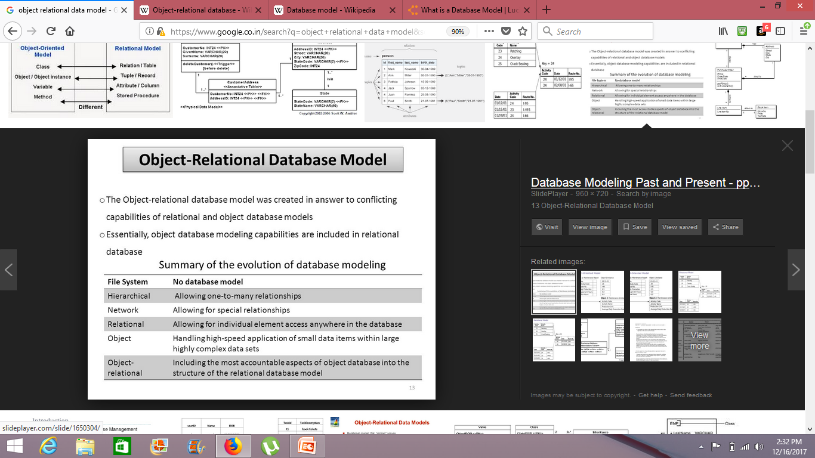

Slide 32
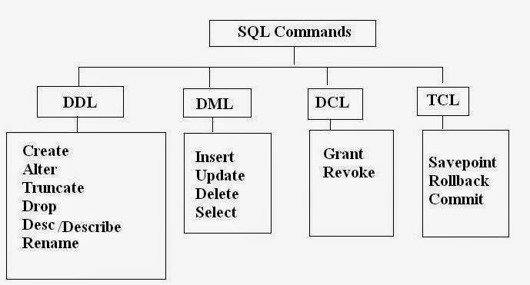

Slide 33
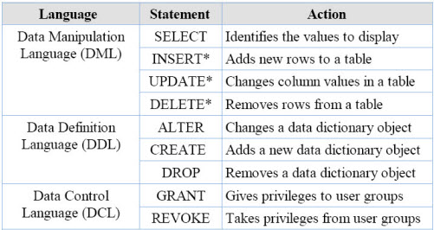

Slide 34
Select
  Unique
  Distinct
  Count
  As
  In
  Sum
  IS NULL
  IS NOT NULL
  ORDER BY
  AND, OR

Slide 35
Database users and administration
Database users
  Application Programmers
  Sophisticated users
  Specialized users
  Stand-alone users
  Native Users

Slide 36
Database administrators
Responsibilities of DBA:
  Installing and upgrading DBMS servers
  Design and implementation of databases
  Schema definition , storage structure, access method definition
  Performance Tuning
  Migrate database servers
  Backup and recovery
  Security
  Documentation etc

Slide 37
Types of database administrators
Administrative DBA
Development DBA
Database Architect
Data warehouse DBA
Application DBA
OLAP DBA

Slide 38
Transaction management
Transaction
Partial transactions
Concurrent execution of transactions
Locking protocol
Locks
Shared locks
Exclusive locks
Incomplete transactions
System crashes
Log
Write Ahead Log (WAL)
Checkpoint
Periodic checkpoints

Slide 39
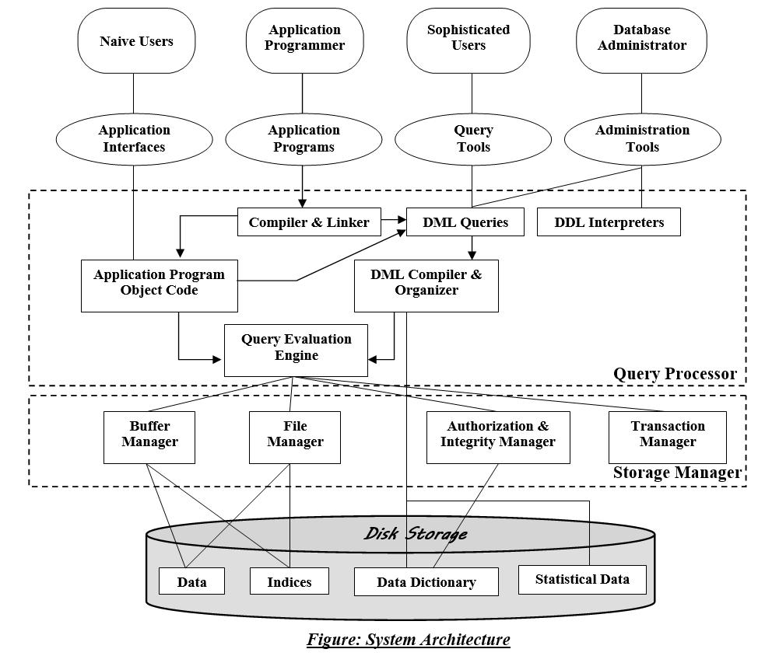
Database system structure

Slide 40
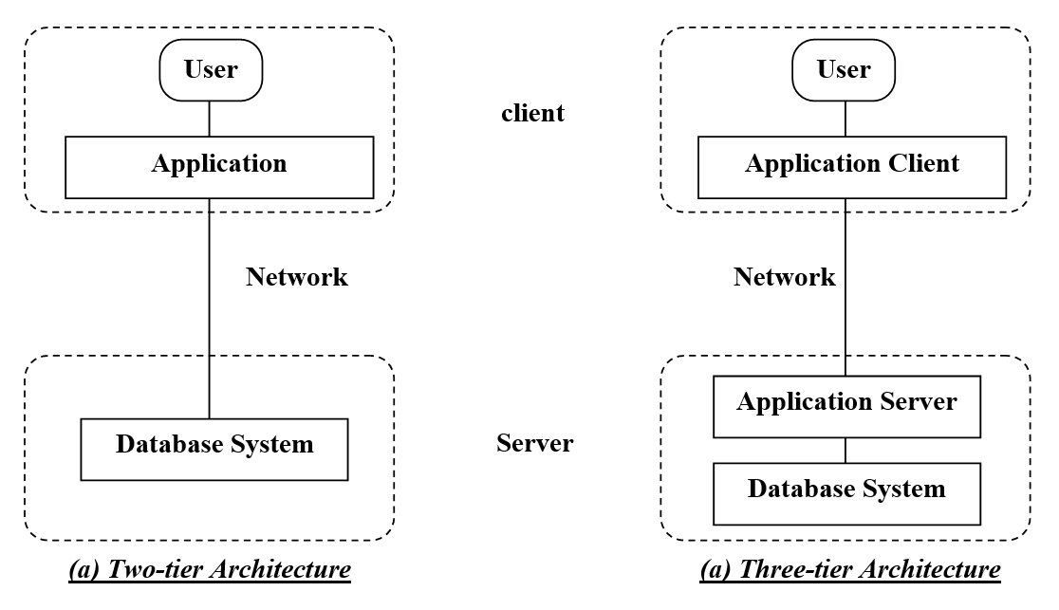

Slide 41
Introduction to database design
Database design process steps
Requirement Analysis
Conceptual database design
Logical database design
Schema refinement
Physical database design
Application and security design

Slide 42
E -R diagrams
The E-R data model allows us to describe the data involved in a real-world enterprise in terms of objects and their relationships and is widely used to develop an initial database design.

Slide 43
Entities
An entity is an object in the real world that is distinguishable from other objects.
An Entity can be any object, place, person or class.
an entity is represented using rectangles.
Works for
Department
Employee

Slide 44
Weak entity
Weak entity is an entity that depends on another entity. Weak entity doesn't have key attribute of their own. Double rectangle represents weak entity.

Slide 45
attributes
An Attribute describes a property or characteristic of an entity. For example, Name, Age, Address etc can be attributes of a Student. An attribute is represented using eclipse

Slide 46
Types of attributes
Key attribute
Composite attributes
Derived attributes

Slide 47
Entity sets

Slide 48
relationships
A Relationship describes relations between entities. Relationship is represented using diamonds
Relationship is an association among 2 or more entities
There are three types of relationship that exist between Entities.
Binary Relationship
Recursive Relationship
Ternary Relationship

Slide 49
relationship sets
Collection of set of similar relationships is called a relationship set.

Slide 50
additional features of the E
-R model
Key constraints
Key constraints for ternary relationships
Participation constraints(partial and complete)
Class hierarchies
Aggregation

Slide 51
conceptual design with the
E-R model
Entity versus attribute
Entity versus relationship
Binary versus ternary relationships
Aggregation versus ternary relationships

Slide 52
conceptual design for large enterprises

Slide 53
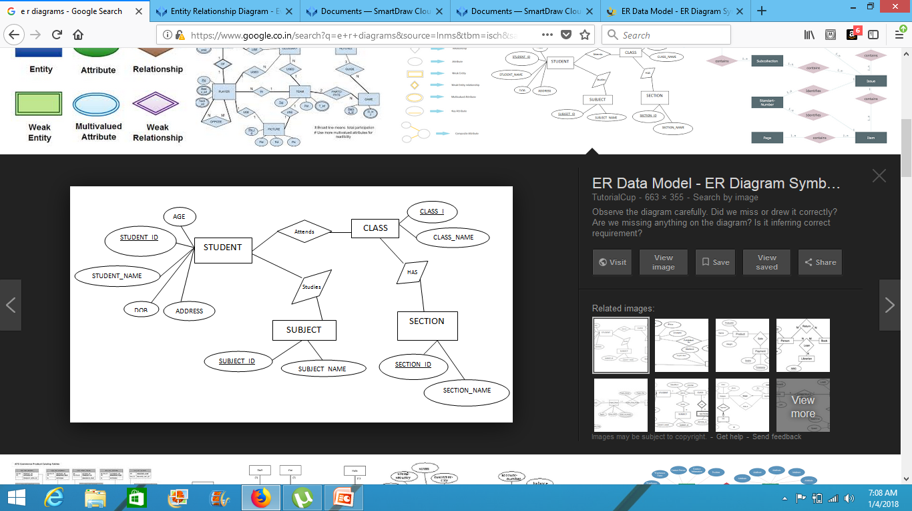

Slide 54
A college contains many departments
Each department can offer any number of courses
Many instructors can work in a department
An instructor can work only in one department
For each department there is a Head
An instructor can be head of only one department
Each instructor can take any number of courses
A course can be taken by only one instructor
A student can enroll for any number of courses
Each course can have any number of students

Slide 55
Step 1 : Identify the Entities
Stem 2 : Identify the relationships
Step 3: Identify the key attributes
Step 4: Identify other relevant attributes
Step 5: Draw complete ER diagram

Slide 56
Step 1 : Identify the Entities
What are the entities here?
From the statements given, the entities are
Department
Course
Instructor
Student

Slide 57
Stem 2 : Identify the relationships
One department offers many courses. But one particular course can be offered by only one department. hence the cardinality between department and course is One to Many (1:N)
One department has multiple instructors . But instructor belongs to only one department. Hence the cardinality between department and instructor is One to Many (1:N)
One department has only one head and one head can be the head of only one department. Hence the cardinality is one to one. (1:1)
One course can be enrolled by many students and one student can enroll for many courses. Hence the cardinality between course and student is Many to Many (M:N)
One course is taught by only one instructor. But one instructor teaches many courses. Hence the cardinality between course and instructor is Many to One (N :1)

Slide 58
Step 3: Identify the key attributes
"Departmen_Name" can identify a department uniquely. Hence Department_Name is the key attribute for the Entity "Department".
Course_ID is the key attribute for "Course" Entity.
Student_ID is the key attribute for "Student" Entity.
Instructor_ID is the key attribute for "Instructor" Entity.

Slide 59
Step 4: Identify other relevant attributes
For the department entity, other attributes are location
For course entity, other attributes are course_name,duration
For instructor entity, other attributes are first_name, last_name, phone
For student entity, first_name, last_name, phone

Slide 60
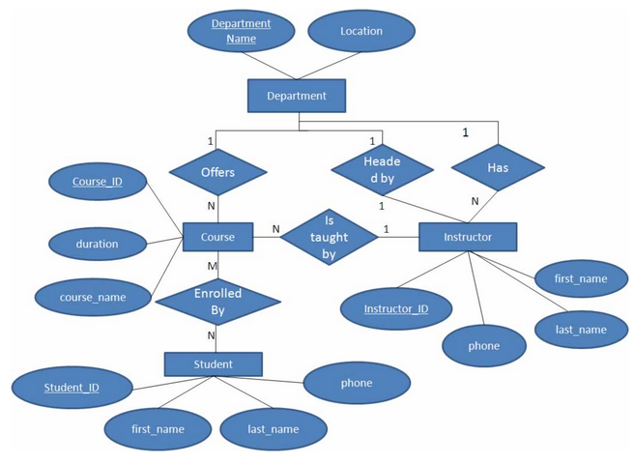

Slide 61
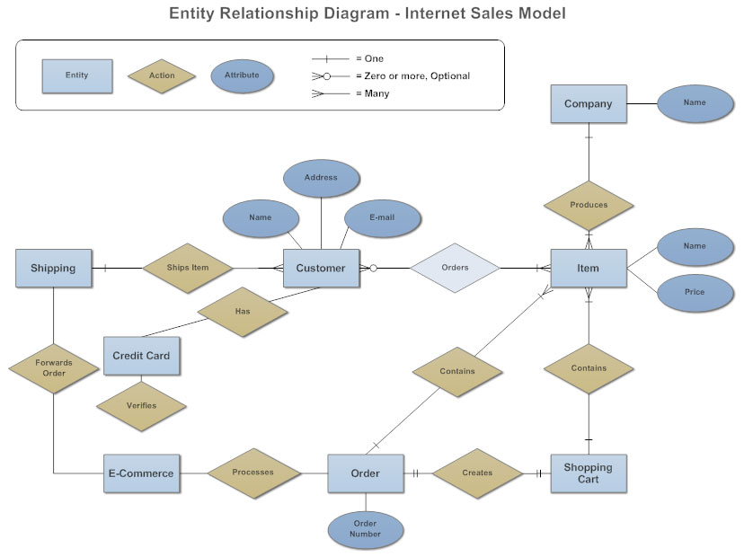

Slide 62
A typical example could be entities Customer, Order, and Product.
An instance of the Customer entity is identified by a unique customer number,
an instance of the Order entity is identified by a unique order number, and
an instance of the Product entity is identified by a unique product number.

Slide 63
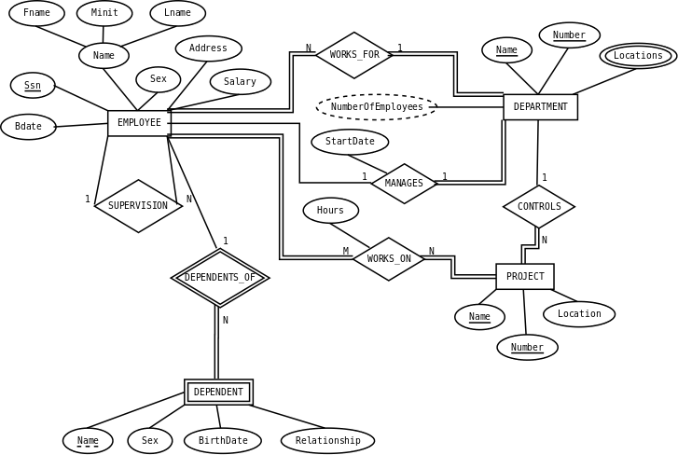

Slide 64
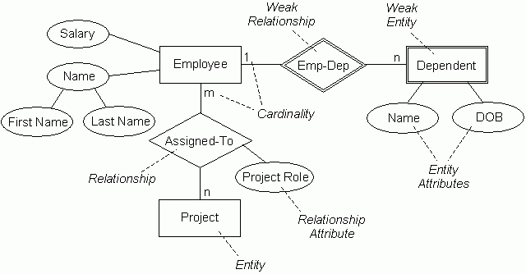

Slide 65
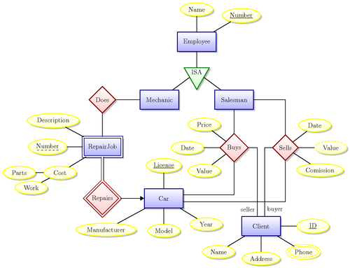

Slide 66
